Slide 1
Router Config
Muhammad Ali

Slide 2
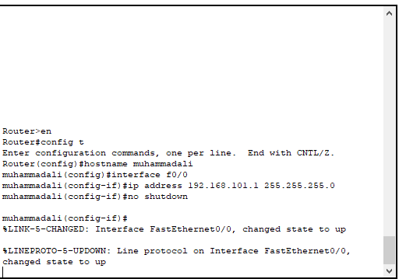
Router config
Router config

